Slide 1
AN INVISIBLE
TRAP
By Subodha Peiris

Slide 2


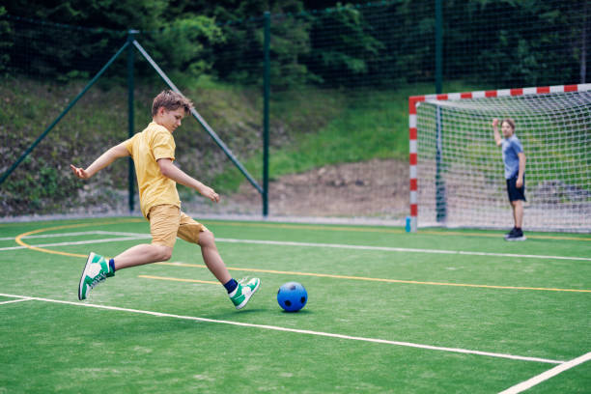

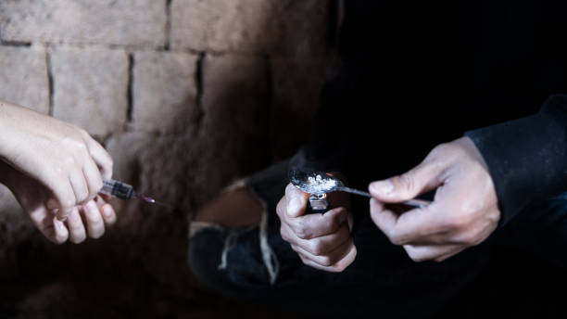

Change in a Life

Slide 3



STAGES
1. Experimentation
2. Daily Using
3. Addiction

Slide 4


A GLOBAL ISSUE

Slide 5



Tame Your Mind
Meditation
Good Friends

